Slide 1
Introduction to Digital Humanities
Tassie Gniady
Manager, Cyberinfrastructure for Digital Humanities
Indiana University
September 2, 2016
Supplemental line if need be (example: Supported by the National Science Foundation) Delete if not needed.
Notes:
Intro Slide

Slide 2
What is Digital Humanties?
Digital humanities (DH) is an area of scholarly activity at the intersection of computing and the disciplines of the humanities. The nature of this activity ranges broadly, from the practical, such as digitizing historical texts, to the philosophical, such as reflection on the nature of representation itself. (Wikipedia)
The digital humanities is increasingly becoming a "buzzword", and there is more and more talk about a broadly conceived, inclusive digital humanities. The field is expanding and at the same time being negotiated, and this article explores the idea of a broadly conceived landscape of digital humanities in some depth. It is argued that awareness across this landscape is important to the future of the field. (Patrick Svensson in 2010, “The Landscape of Digital Humanities”)

Slide 3
Tara McPherson’s Three Modes
In a 2008 talk Tara McPherson suggested three modes of DH
computing humanities (focuses on building tools, infrastructure, standards, and collections)
blogging humanities (concerned with the production of networked media and peer-to-peer writing)
multimodal humanities (brings together scholarly tools, databases, networked writing and peer-to-peer commentary while also leveraging the potential of the visual and aural media that are part of contemporary life)

Slide 4
Brett Bobley, Director of the Office of Digital Humanities
First, let me briefly explain what we mean by "digital humanities." Not that this is an official, formal definition (this is the humanities, after all!). But I use "digital humanities" as an umbrella term for a number of different activities that surround technology andhumanities scholarship. Under the digital humanities rubric, I would include topics like open access to materials, intellectual property rights, tool development, digital libraries, data mining, born-digital preservation, multimedia publication, visualization, GIS, digital reconstruction, study ofthe impact of technology on numerous fields, technology for teaching and learning, sustainability models, media studies, and many others. It became way too exhausting to recite that entire list whenever I spoke with someone, so "digital humanities" seemed to nicely summarize the issues. (Plus, it sounded better to me than "e-humanities" which is what I used to use!). –interview with HASTAC Scholars Kathleen Smith and Michael Gavin in 2009

Slide 5
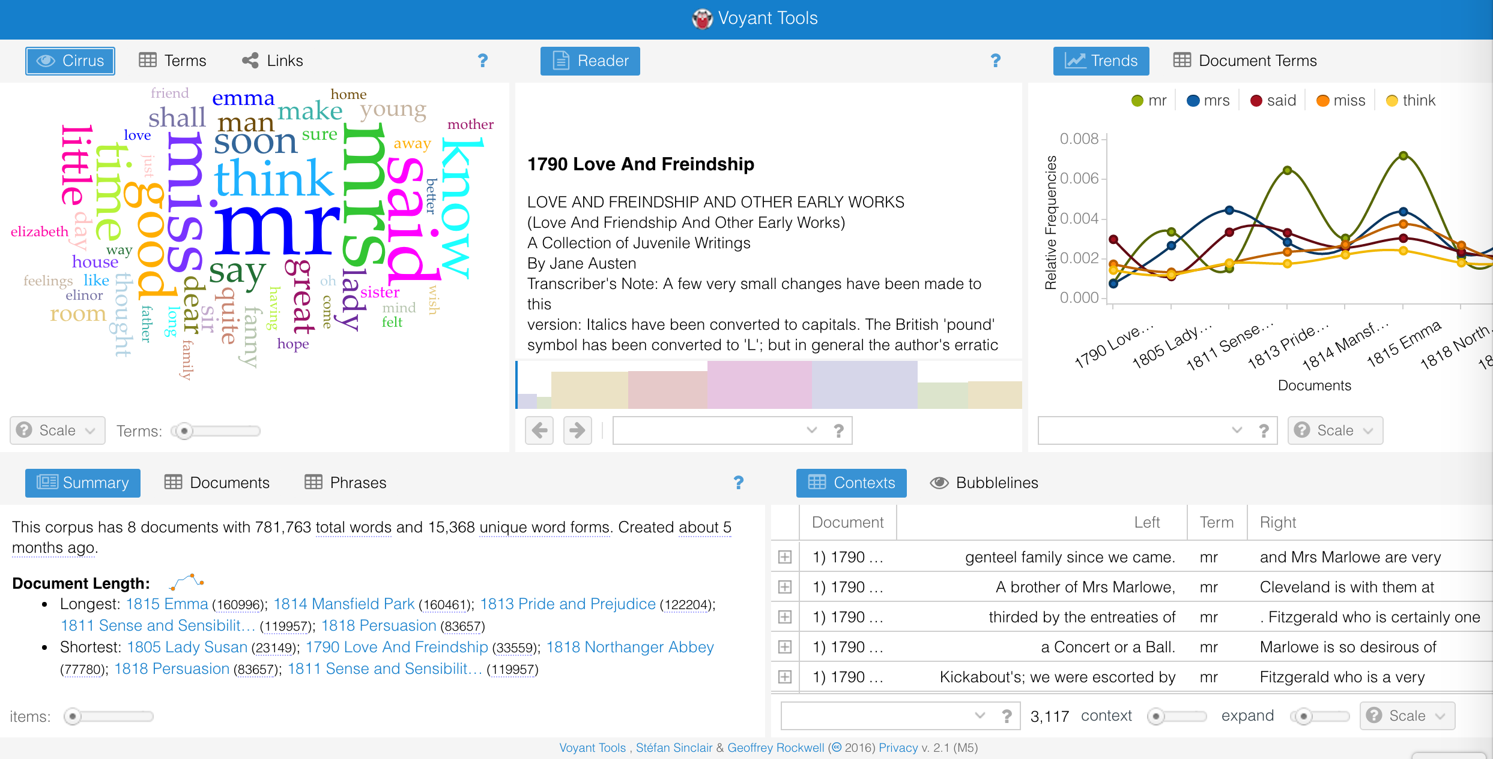
Ok...Can You Be More Concrete? Part 1: Tools, Voyant

Slide 6
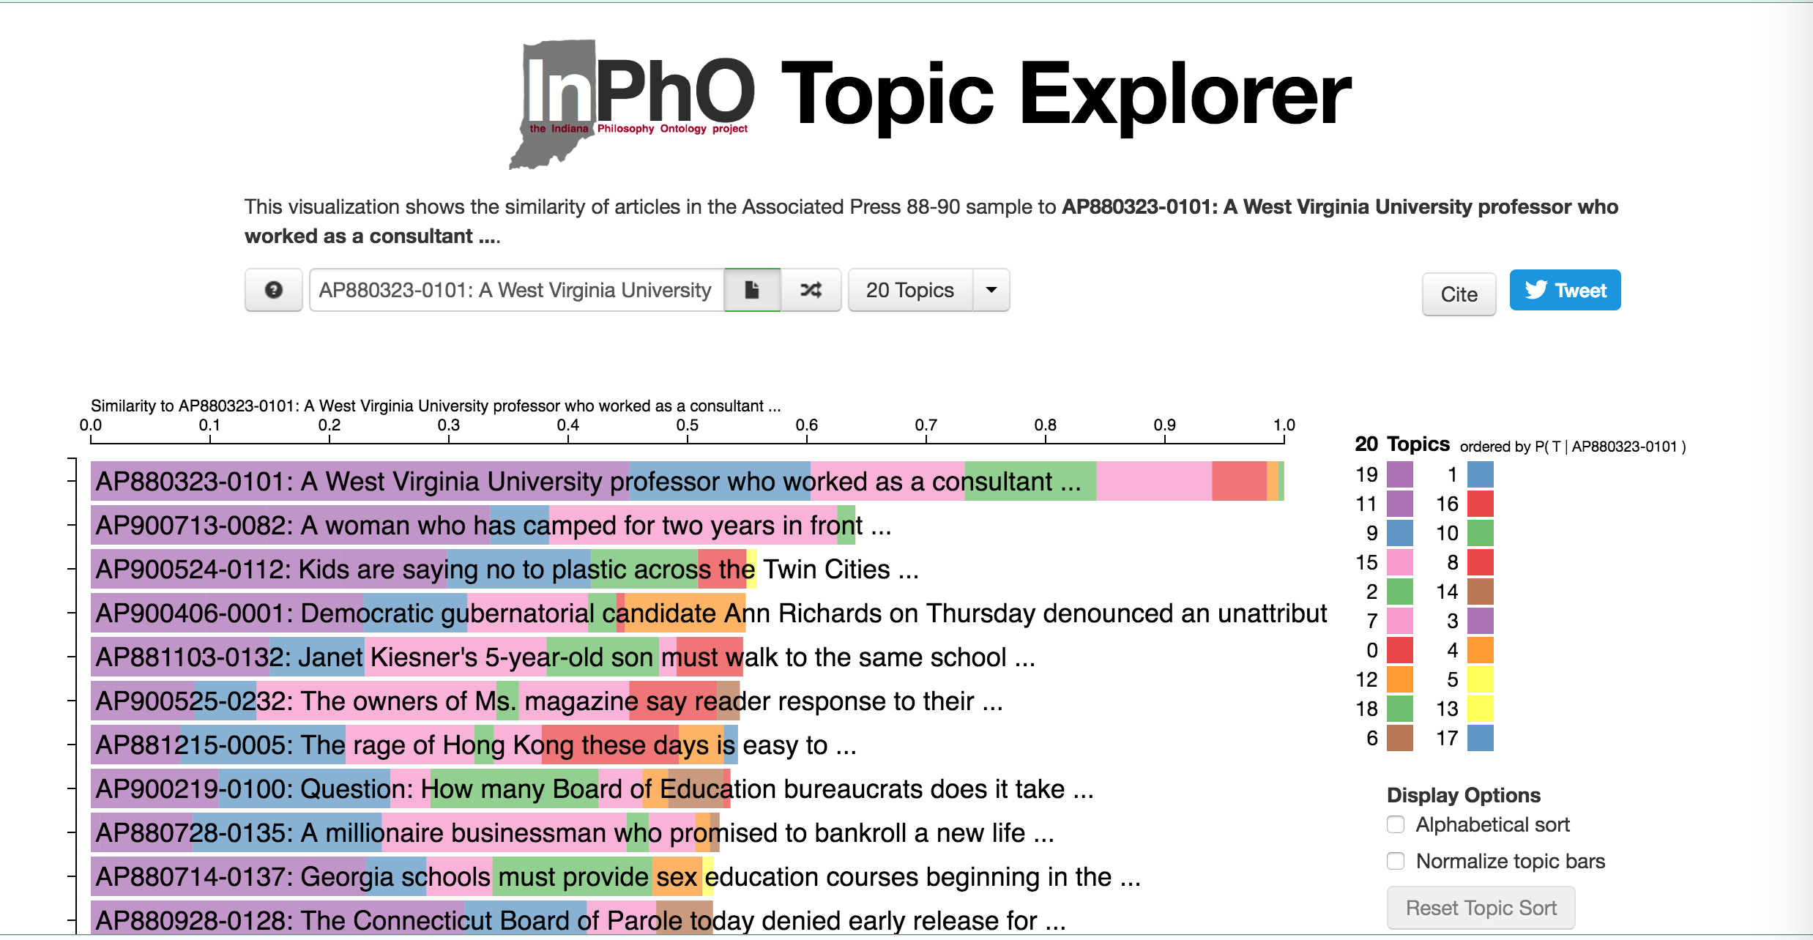
Tools, cont. Topic Modeling with InPhO

Slide 7
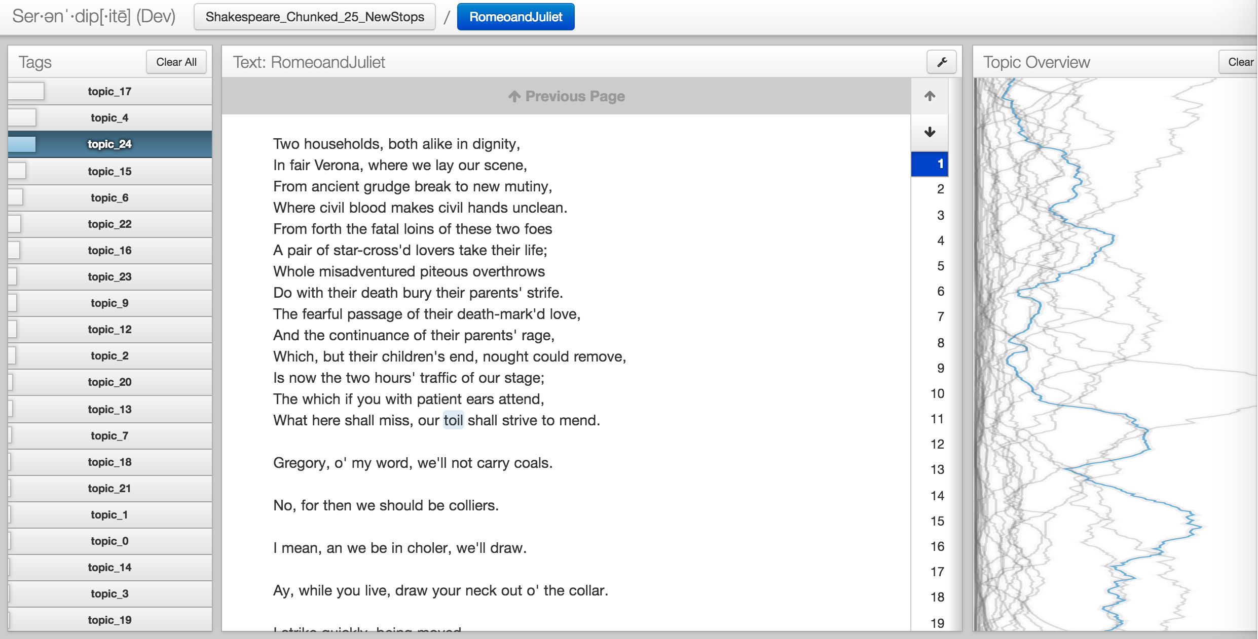
Tools Topic Modeling with Serendip

Slide 8
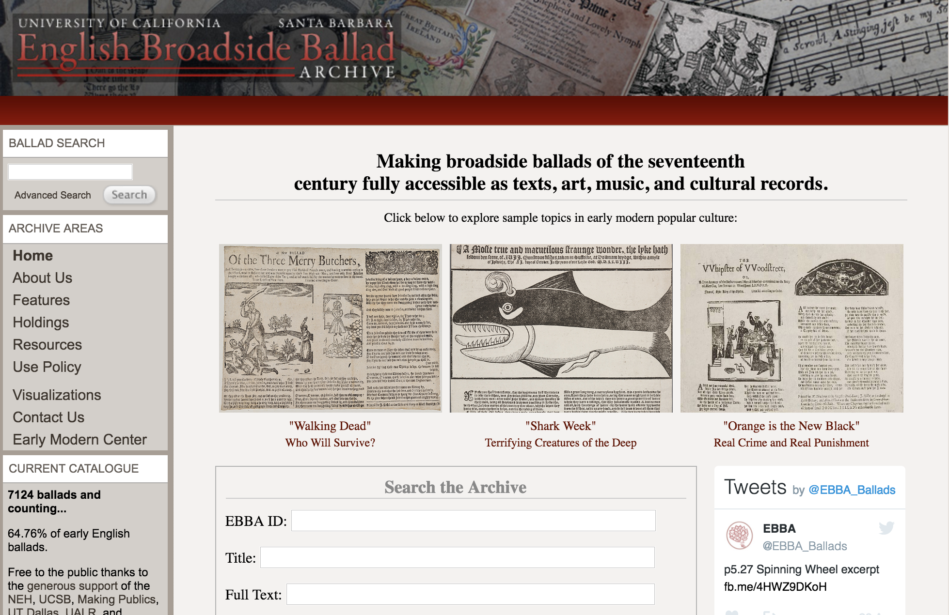
Projects Early English Broadside Ballad Archive

Slide 9
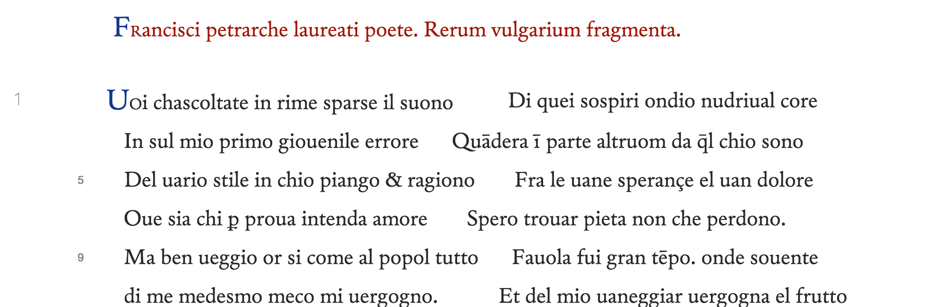
Projects Petrarchive

Slide 10
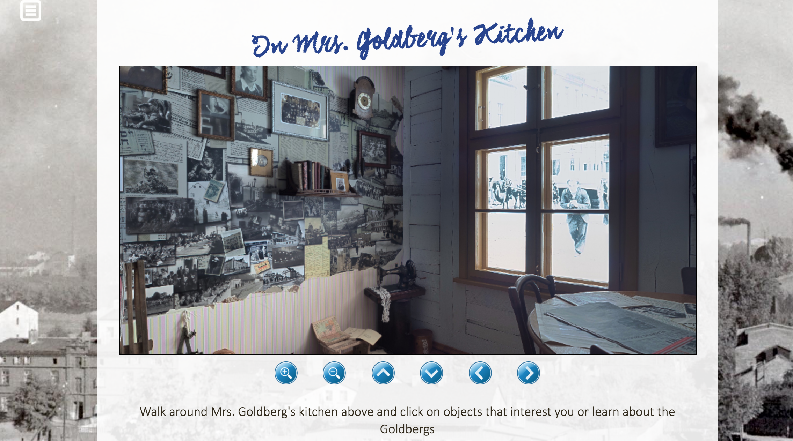
Projects Jewish Life in Interwar Łódź

Slide 11
People (an incomplete list, I’m sure)
Ellen MacKay, Director, IDAH
Clara Henderson, Associate Director, IDAH (director of HASTAC Scholars Program)
Michelle Dalmau, Head, Digital Collections Services
Will Cowan, Software Development Head (Omeka expert)
Nick Homenda, Digital Initiatives Librarian
Angela Courtney, Director, Scholars Commons
Tassie Gniady, CyberDH Manager, Adjunct Instructor Information and Library Science
Michael Boyles, Advanced Visualization Lab Manager
Jason Baird Jackson, Professor of Folklore, Director, Mathers Museum of World Cultures
Bernie Frischer, Professor of Informatics, Director, Virtual World Heritage Laboratory
Matthew Brennan, PhD Candidate, Digital Heritage, SOIC
Colin Allen, Professor, History of Science & Medicine, Cognitive Science
Jamie Murdock, PhD Candidate, Cognitive Science
Kalani Craig, Clinical Assistant Professor, History
Stacie King, Associate Professor, Anthropology
Markus Dickinson, Associate Professor of Linguistics
John Walsh, Associate Professor, Information and Library Science
Katy Borner, Victor H. Yngve Professor of Information and Library Science
Jennifer Guiliano, Assistant Professor of History & Director, HILT, IUPUI; President, ACH
IDAH Faculty Fellows
IDAH HASTAC Scholars

Slide 12
Organizations
IDAH
HathiTrust Research Center
Cyberinfrastructure for Network Science Center
InPhO
Virtual World Heritage Laboratory
Digital Collections Services
CyberDH
HILT
Advanced Visualization Lab

Slide 13
Contact
Tassie Gniady
ctgniady@iu.edu
@tassietheg
Manager, Cyberinfrastructure for Digital Humanities
cyberdh@iu.edu

